Slide 1
ERD Mapping to Tables
Lecturer: Salma Mamdouh
smamdouh@mcit.gov.eg
Room:3005
Made by:
Shahinaz S. Azab
Edited by:
Mona Saleh

Slide 2
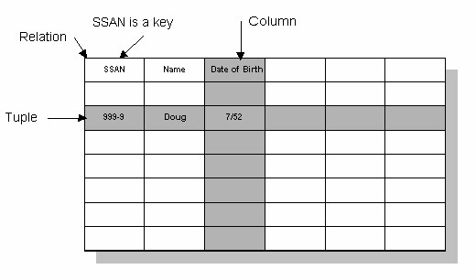
Relational Database
Domain
Notes:
Integrity Constraints : ( PK, UK, NN, FK, Check)
Data types

Slide 3
ER-to-Relational Mapping
Step 1: Mapping of Regular Entity Types
Step 2: Mapping of Weak Entity Types
Step 3: Mapping of Binary 1:1 Relation Types
Step 4: Mapping of Binary 1:N Relationship Types.
Step 5: Mapping of Binary M:N Relationship Types.
Step 6: Mapping of Multi-valued attributes.
Step 7: Mapping of N-ary Relationship Types.

Slide 4
Step 1: Mapping of Regular Entity Types
Create table for each entity type
Choose one of key attributes to be the primary key

Slide 5
Step 2: Mapping of Weak Entity Types
Create table for each weak entity.
Add foreign key that correspond to the owner entity type.
Choose the primary key : ( FK + weak entity Partial PK if any)

Slide 6
Step 3: Mapping of Binary 1:1 Relation Types
Merged two tables if both sides are Mandatory.
Add FK into table with the total participation relationship to represent optional side.
Create third table if both sides are optional.

Slide 7
Step 4: Mapping of Binary 1:N Relationship Types.
Add FK to N-side table
Add any simple attributes of relationship as column to N-side table.

Slide 8
Step 5: Mapping of Binary M:N Relationship Types.
Create a new third table
Add FKs to the new table for both parent tables
Add simple attributes of relationship to the new table if any .

Slide 9
Step 6: Mapping of Multi-valued attributes.
Create new table for each multi-valued attribute
Table will include two columns.
one for multi-valued attribute + FK column.

Slide 10
Step 7: Mapping of N-ary Relationship Types.
If n > 2 then :
Create a new third table
Add FKs to the new table for all parent tables
Add simple attributes of relationship to the new table if any .

Slide 11
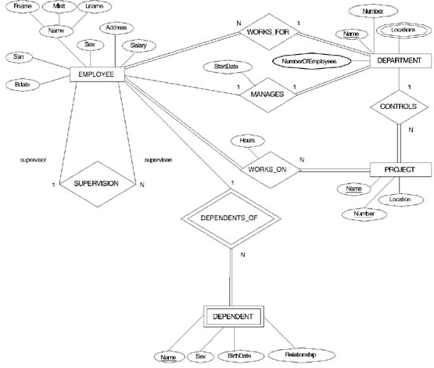


Slide 12

Mapping Result

Slide 13
ERD Case Study
An organization makes many models of cars, where a model is characterized by a unique name and a suffix (such as GL or XL) and an engine size.
Each model is made up from many parts and Each part has a description , an id code, production year, and many images.
each part may be used in the manufacturing of more than one model

Slide 14
ERD Case Study
Each model must be produced at just one of the firm's factories, which are located in London, Birmingham, Bristol, Wolverhampton and Manchester - one in each city. Each factory has number of machines, capacity, and computer system used ( OS , DBMS, Internet).
A factory produces many models of cars and many types of parts. Although the parts and model produced in the same factory.
Notes:
although each type of part is produced at one factory only and the model is produced in the same factory.
Discuss Ternary relationship.

Slide 15

Ternary Relationship

Slide 16
ERD Case Study 2
A country bus company owns a number of buses. A bus is characterized by number, No. of Chairs, Options ( AC , Automatic, PS) , and brand-name
Each bus is allocated to a particular route, although some routes may have several buses . Each route is described by KM, start point, end point and the duration.

Slide 17
ERD Case Study 2
Each route can passes through a number of towns.
A town may be situated along several routes. We keep track of unique name and station name in each town.
One or more drivers are allocated to one route during a period of time. The system keep information about the driver name , mobile number , hire date, basic salary , job grade.
The system keep information about any changes in the allocations of the drivers to the routes and the last route assigned to each driver.
Notes:
Oute

Slide 18
ERD Narrative
A database for a banking system is used to control withdrawal, deposit and loan transactions with customers.
Banks which use this system have many branches; each branch has a unique name, unique address and phone.
The system stores information about customers as unique customer ID, name, address, and phones.

Slide 19
ERD Narrative ( Cont’d)
Each customer has one Account identified by unique Account number, amount, last transaction date (Day, Month and Year).
The system records Transaction number, Transaction type, Transaction date, Transaction amount and time. The system records the branch name where the transaction occurred.
A Customer can make any type of transactions (Withdrawal or Deposit) from any branch of the bank.

Slide 20
Questions?

